Slide 1
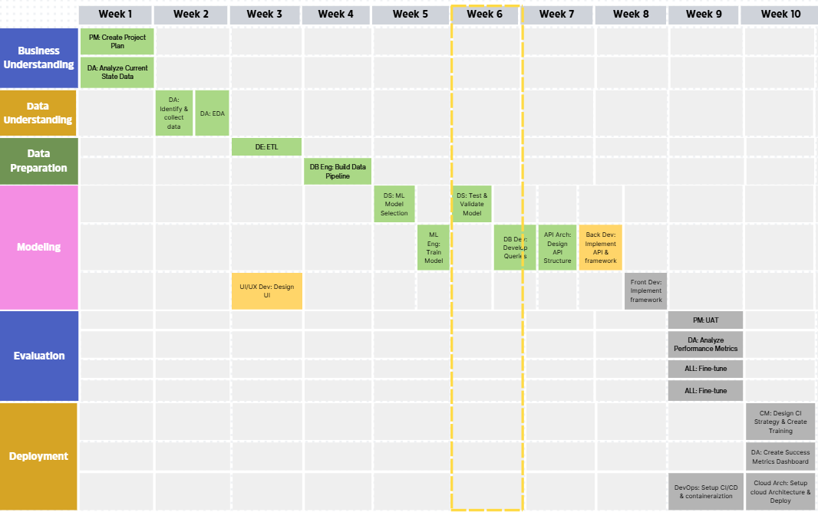
Week 6 Status Report: Automated Task Assignment System – Sue Byeon
Status: On Time
Pending Items:
Implement API & Framework
Design UI

Slide 2
Accomplishments
Next Steps
Completed Data Transformation: Performed data cleaning and feature engineering to prepare the dataset for analysis.
Conducted Exploratory Data Analysis (EDA): Analyzed data distributions, identified patterns, and visualized key relationships to inform modeling decisions.
Imported Data into a Database: Loaded processed data into a database for efficient querying and management.
Developed Machine Learning Algorithm: Selected, trained, and fine-tuned an appropriate ML model based on project objectives.
Model Evaluation: Assessed model performance using relevant metrics (e.g., accuracy, precision, recall) and validated results.
Developed Queries and API Calls: Created and tested queries and API endpoints to support data retrieval and model interaction.
Design UI Components: Create user interface elements for interacting with the model and displaying results.
Integrate Frontend and Backend: Connect the user interface with backend services and machine learning APIs.
Create Cloud Environment: Set up cloud infrastructure to host the application and ML model.
Prepare Final Presentation: Summarize the project, results, and key learnings for stakeholder review.
Risk and Issues | Description | Status
Model Performance Risk | The limited size of the training dataset may result in suboptimal model performance and reduced prediction accuracy. To address this, I have fine-tuned model training parameters to better suit the available data. | Mild
Resource Constraint Risk | There is a risk of insufficient access to, or familiarity with, the necessary tools, hardware, or cloud services required for deployment. To mitigate this, I am conducting thorough research to identify the most suitable platforms and tools for cloud deployment. | Mild

